Slide 1
HOSA November General Meeting
Wednesday, November 9th, 2022

Slide 2
Join the Remind!
9th & 10th- @phulower23
11th & 12th- @phuupper23

Slide 3
Follow us on Instagram!
@phuhs_hosa

Slide 4
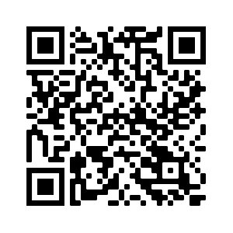
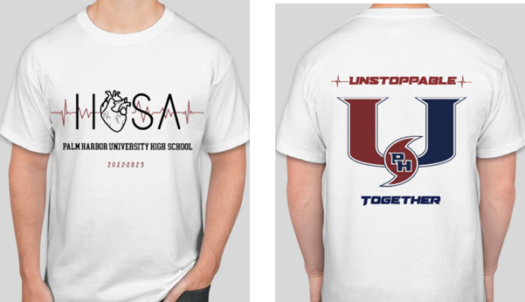
T-Shirt Sales
Buy Here!!
Price: $10.00
Due: November 18th

Slide 5
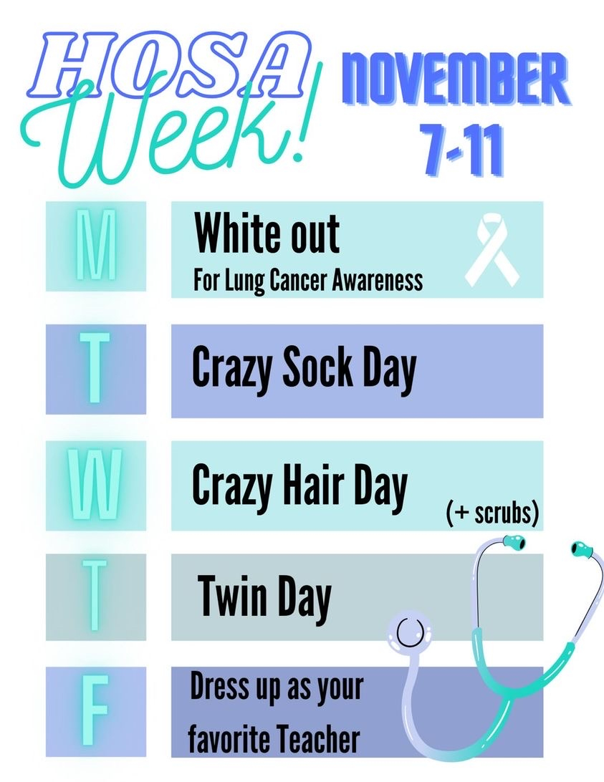
HOSA Week!
Reminder: There are still two more days of HOSA week! So, show your HOSA spirit on Thursday with Twin day, and Friday with Dress up as your favorite teacher day!

Slide 6
Regionals Date
Saturday, January 21st
If you are signed up for a competition and are unable to come on that day, PLEASE let us know today!!

Slide 7
Regionals Testing
December 5th-9th
If you are signed up for a competition that requires testing, it will be held during the first week of December. Once we receive specific dates we will let you all know and send them out!
***Everyone who is signed up for an event will be testing for the Healthcare Issues exam!

Slide 8
Competition Fees
Amount Due: $10.00
If you are competing at Regionals you MUST pay your competition fees!!
Payment will be held on Revtrak, we will send the link out once it has been put up!

Slide 9
Competition Meetings
November 16th & January 11th
These meetings are mandatory, and if you have a conflict, you must let us know and set up an alternative date with your competition advisor!!

Slide 10
Kimberly Home Ornament Making
Ornament making will be held TODAY, immediately after our meeting in Room 6-104! We will be making ornaments to hand out for those who are going to buy a gift for Kimberly Home!

Slide 11
Kimberly Home Donations
Due: December 9th
Medical teachers will be handing out ornament assignments to those interested! Everyone who completes an ornament assignment will receive 2.5 medical hours (5 hours max) and 1 HOSA point (2 points max) per item!!

Slide 12
Kimberly Home Celebration
December 14th
After our next HOSA meeting we will be holding a celebration for the Kimberly Home and our club’s philanthropic efforts!
There will be pizza, cookies, refreshments, and fun! So, make sure to be there!

Slide 13
Points Reminder
In order to become an active member at the end of the year, you must obtain the required amount of points! We will be updating everyone on points before the next meeting!
9th & 10th: 10 points
11th & 12th: 15 points

Slide 14
HOSA Pins
All IB students and senior biomed students, please see Mrs. Webb to receive your HOSA pin!!
For everyone else, you will be receiving your pins in your medical class!

Slide 15
Next Meeting: December 14th

Slide 16
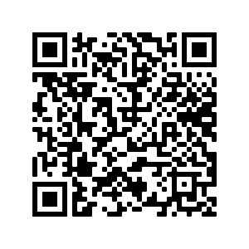
Attendance

